Slide 1
Frantz Fanon (Pt 1)

Slide 2
Phenomenology
- This is an ontological approach which espouses human consciousness and interaction with the world rather than a series of mental abstractions.
- Intentionality of consciousness is crucial - subject and object.
- ‘Nothingness’ and ‘nausea’.

Slide 3
‘we are condemned to be free having been thrown into an absurd world without intrinsic rules or structure, with neither God nor any fixed system, for guidance, we are fully responsible for our own actions’

Slide 4
"associated in minds the word France and the word liberty, and that bound
us to France by every fiber of our hearts and every power of our minds"
(as cited in Hall 1995: 10).
'that all her sons, without any colour discrimination, faithfully serve
under her flag, and that there is no better answer to the detractors of
an alleged colonialism than the zeal shown by this Negro in serving
his so-called oppressors' (cited in Young 1991: 123).
"brought with him not only memories regarding the horrors of war
but also serious doubts about his identity as a Frenchman" (1985: 28).

Slide 5
The Desire to be White
"There is a fact: White men consider themselves superior to black men. There is another fact: Black men want to prove to white men, at all costs, the richness of their thought, the equal value of their intellect" (12).
"I believe that the fact of the juxtaposition of the white and black races has created a massive psychoexistential complex. I hope by analyzing it to destroy it" (Fanon 1986: 14).
“The Frenchman does not like the Jew, who does not like the Arab,who does not like the Negro...The Arab is told: 'If you are poor, it isbecause the Jew has bled you and taken everything from you'. The Jew is told: 'you are not the same class as the Arab because you arereally white because you have Einstein and Bergson'. The Negro is told you are the best soldiers in the French Empire; the Arabs thinkthey are better than you, but they are wrong" (103).

Slide 6
"is less to account for white negrophobia than to explore the lived- experience and moral possibilities open to a black living in a negrophobic world" (1996: 128).
"basic concept of nonbeing that he used to describe the conditions of aridity and paralysis that often follow ego collapse" (Henry 1996: 234).
“Look a Negro!' It was an external stimulus that flicked over me as
I passed by. I made a tight smile. 'Look a Negro!' It was true. It amused me.
'Look a Negro!' The circle was drawing a bit tighter. I made no secret of my
amusement. 'Mama, see the Negro! I'm frightened! Frightened! Frightened!
Now they were beginning to be afraid of me. I made up my mind to laugh myself
to tears, but laughter had become impossible”.

Slide 7
Nausea
In the train it was no longer a question of being aware of my body in the third
person but in a triple person. In the train I was given not one but two, three
places. I had already stopped being amused. It was not that I was finding febrile
(feverish) coordinates in the world. I existed triply: I occupied space. I moved
toward the other ... and the evanescent other, hostile but not opaque, transparent
not there, disappeared. Nausea....(112).

Slide 8
"It was hate; I was hated, despised, detested, not by the neighbours across the street or my cousin on my mother's side, but by an entire race" (Fanon 1986: 118).
'On that day, completely dislocated, unable to be abroad with the other, the white man, who unmercifully imprisoned me, I took myself far off from my own presence, far indeed and made myself an object. What else could it be for me but an amputation, an excision, a hemorrhage that spattered my whole body with black blood? But I did not want this revision, this thematization. All I wanted was to be a man among other men' (112).

Slide 9
“Was my freedom not given to me in order to build the world of You ? At the
conclusion of this study, I want the world to recognize, with me, the open door
of every consciousness” (232)
"image of the post-Enlightenment man tethered to, not confronted by his dark
reflection, the shadow of colonized man" (1986: xiv).

Slide 10
  "the underside of Western humanism produces the dictum that since
  some Human beings are more human than others, they are more
  substantially the measure of all things' (30).
  For generations now, philosophers and thinkers shaping
  The nature of social science have produced theories embracing the
  entirety of humanity; as we well know, these statements have been
  produced in relative, and sometimes absolute, ignorance of the
  majority of humankind i.e., those living in non-Western cultures
  (1992: 3; 2000)

Slide 11
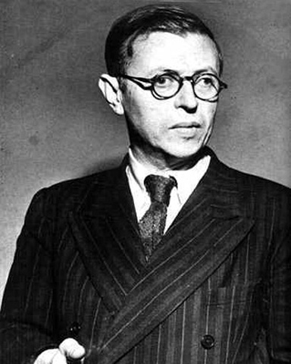
Colonial Violence and New Humanism
...for we in Europe too are being decolonized: that is to say that the settler which is in every one of us is being savagely rooted out…we must face that unexpected revelation the strip-tease of our humanism...It was nothing but an ideology of lies, a perfect justification for pillage; its honeyed words, its affectation of sensibility were only alibis for our aggressions (Sartre in Fanon 1967: 21).

Slide 12
‘The zone where the natives live is not complementary to the zone
inhabited by the settlers. The two zones are opposed, but not in the
service of a higher unity...they both follow the principle of reciprocal
exclusivity. No conciliation is possible, for the two terms, one is
superfluous. The settlers town is a strongly built town, all made of stone
and steel...a well-fed town, an easy-going town; its belly is always full of
good things. The settlers town is a town of white people, of foreigners.
The town belonging to the colonized people, or at least the native town,
the Negro village, the medina, the reservation, is a place of ill fame,
peopled by men of evil repute. They are born there, it matters little where
or how; they die there, it matters not where, nor how. It is a world
without spaciousness...a hungry town starved of bread, of meat, of shoes,
of coal, of light...a town of niggers and dirty Arabs’ (1967: 39).

Slide 13
...for the colonized people this violence, because it constitutes their
only work, invests their characters with positive and creative
qualities. The practice of violence binds them together as a whole,
since each individual forms a violent link in the great chain, a part of
the great organism of violence which has surged upwards in reaction
to the settlers' violence in the beginning (1967: 87).

